Slide 1
PRECLINICAL TESTING
&
PHASES OF CLINICAL TRIALS
Saket Ghaisas

Slide 2
DISCLAIMER
The information presented is intended for general information purposes only and not as advice for managing specific circumstances.
The opinions expressed are based on the speaker’s knowledge and published literature and do not necessarily reflect the views of any organization, the speaker was/ is associated with.

Slide 3
What is a drug?
WHO definition of drug:
Any substance or product that is used, or intended to be used to modify or explore physiological systems or pathological states for the benefit of the recipient
Does not impart new function to cell

Slide 4
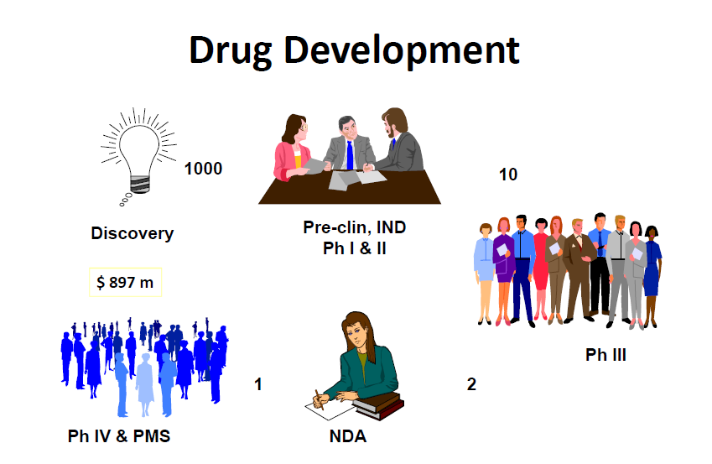
NEW DRUG DEVELOPMENT

Slide 5
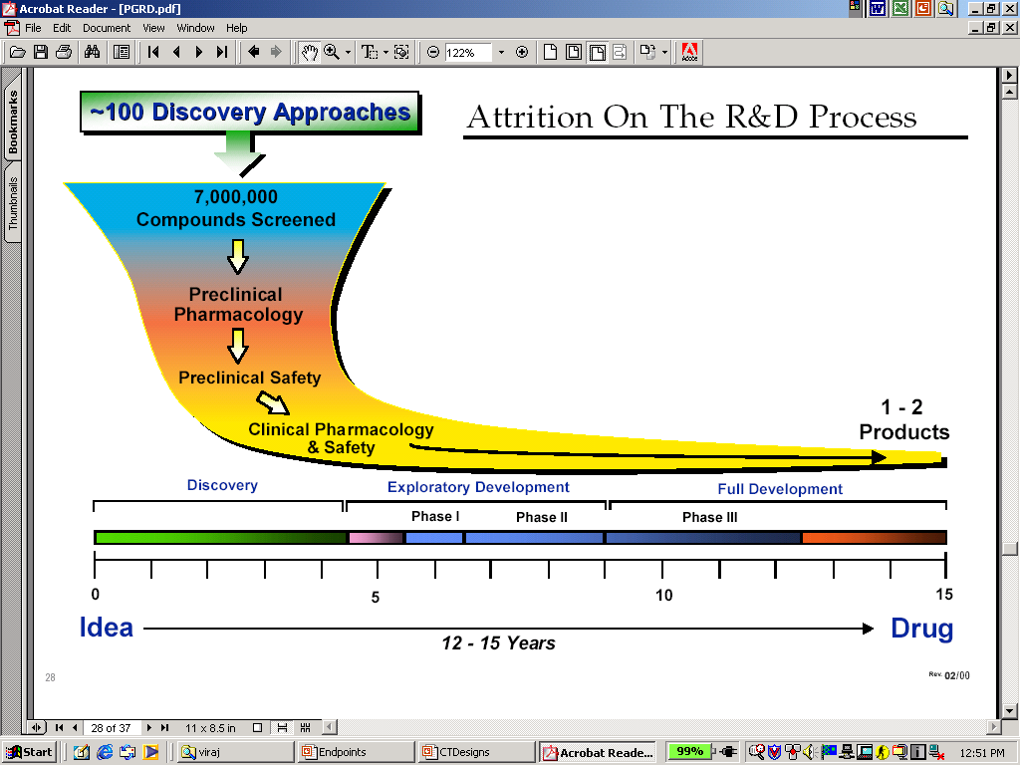
NDD: OVERVIEW

Slide 6
PRE-CLINICAL TESTING

Slide 7
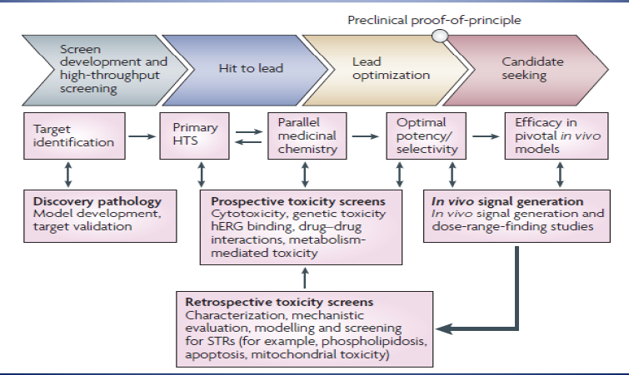
First Step….

Slide 8
EFFICACY TESTING

Slide 9
Animal Model
What is a laboratory animal model?
  an animal model in which normative biology or behavior can be studied, or in which a spontaneous or induced pathological process can be investigated, and in which the phenomenon in one or more respects resembles the same phenomenon in humans or other species of animal.
  U.S. National Research Committee on Animal Models for Research on Aging

Slide 10
Types of animal models
Induced (experimental) disease models
Spontaneous (genetic) disease models
Transgenic disease models
Negative disease models
Orphan disease models

Slide 11
Induced (experimental) disease models
Healthy animals in which the condition being investigated is induced
Inducing diabetes with streptozotocin
Free choice of animal
  AIDS research
Induced disease may not be exactly the same as the human condition

Slide 12
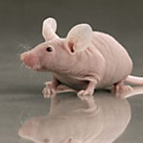
Spontaneous (genetic) disease models
Naturally occurring genetic variants
Hundreds available
  See Jackson labs – www.jax.org
Phenotype of disease in animal often the same as phenotype in humans
Nude mouse
(www.criver.com)
A laboratory mouse from a strain with a genetic mutation that causes a deteriorated or absent thymus, resulting in an inhibited immune system

Slide 13
Transgenic disease models
Incorporation of external DNA into the genome
Transgenic lines can be selected & bred or cloned to avoid or select for a particular genotype
Mutations can also be induced by mutagens which may generate models of human disorders

Slide 14
Negative disease models
Species or strains that are not susceptible to particular diseases
Animals that do not react to a certain stimulus
Mainly used in studies to investigate mechanisms of resistance and its physiological basis

Slide 15
Orphan animal models
A functional disorder that appears naturally in an animal but that has not yet been seen in humans

Slide 16
Primary screen
Behavioural observation
  Irwin, S. (1968), Psychopharmacologia
  General, undisturbed behaviour
  Unusual or stereotyped behaviour
  Semi-quantitative or qualitative data

Slide 17
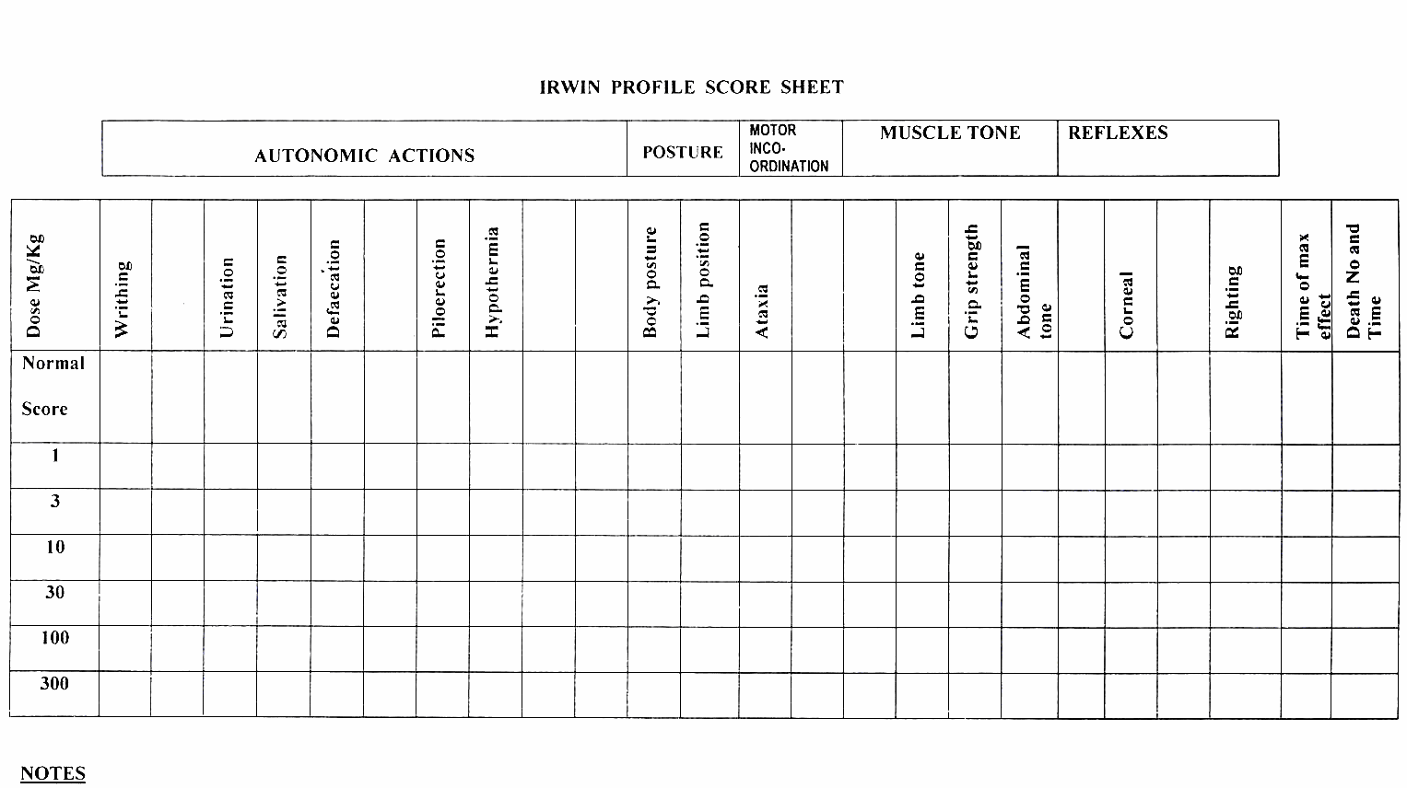
Primary screen

Slide 18
Primary screen
- SHIRPA
Examines numerous behaviours in different environments, including:
  Body position
  Spontaneous activity
  Respiration rate
  Locomotor activity
  Piloerection
  Gait
  Visual placing
  Grip strength
  Pinna and corneal reflex
  Limb tone

Slide 19
Secondary screen
Behavioural and functional screening battery and pathological analysis
Quantification of effects seen in behavioural profile
  Locomotor activity (2hrs or 24hrs)
  Food and water consumption
  Motor coordination (rota-rod)
  Nociception (hot plate)
  Histology and biochemistry
Contet C, Rawlins JN, Deacon RM. (2001) A comparison of 129S2/SvHsd and C57BL/6JOlaHsd mice on a test battery assessing sensorimotor, affective and cognitive behaviours: implications for the study of genetically modified mice. Behavioural Brain Research 124(1), 33-46.

Slide 20
Secondary screen
Normally high throughput. Up to 50 mice per day!
Can detect gross and subtle alterations in behaviour
Can be used to screen candidate drug compounds, phenotypic characterisation of genetically modified mice and comparing two or more strains of mice (or other animals)

Slide 21
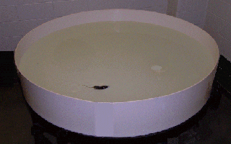
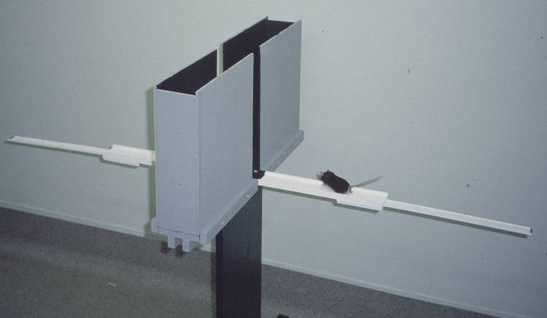
Tertiary screen
Assessment of neurological deficits in mutants or drug-treated mice or a model of neurological disease
Anxiety – open field or elevated plus maze
Learning and memory – Morris water maze
Water maze
(watermaze.org)
Elevated plus maze
(Univ of Oxford)

Slide 22
SAFETY TESTING

Slide 23
Pre-clinical Stage to IND
Acute Toxicity Studies: single dose
Repeat Dose Toxicity Studies: 7 days
Genotoxicity: Ames mutation tests
Phototoxicity
DM/PK
Local Toxicity
Toxicokinetics

Slide 24
Pre-clinical Studies from
IND to NDA
Repeat Dose Toxicity Studies: 3-12 months in M & F rats and dogs/ monkeys
Reproductive Studies: 20 pregnant females/ dose/ species with additional 10 for TK studies
Carcinogenicity Studies: 2 years, 1000 rodents with TK in 250 each in mice and rats

Slide 25
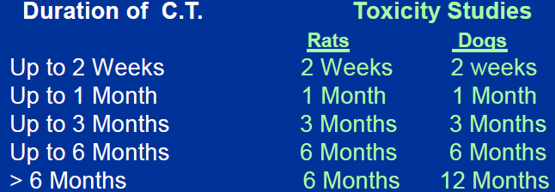
Duration of Toxicology Studies

Slide 26
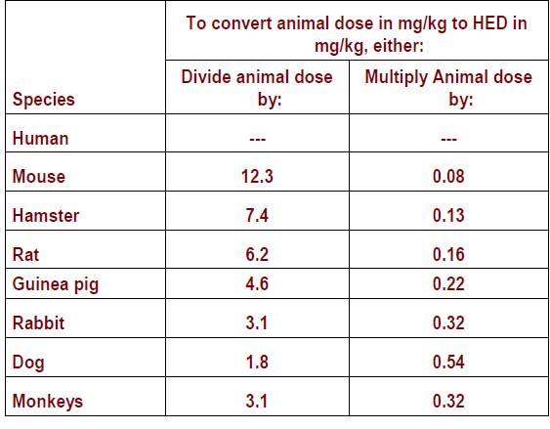
Conversion of Animal Doses to Human Equivalent Dose

Slide 27


Transition
Animal studies
Human studies
Bridging the gap between
animal & human being

Slide 28
What is a Clinical Trial?
“Carefully, and ethically, designed experiment in human beings with the aim of answering some precisely framed question”
Defined by Sir Austin Bradford Hill

Slide 29
Phase 1:
Human Pharmacology
How does the agent affect the human body?
What dosage is safe?

Slide 30
Phase 1
First in Human Studies
Maximum Duration: 1 year
Participants: Healthy humans/ Patients
Age group: 18-45 years
Number: 20-80
Excluded: Children, Elderly, Woman of reproductive age
Dosing: Single or Multiple Ascending Dose
No sample size calculation
Descriptive statistics are used

Slide 31
Phase 1
Objectives:
  Study Pharmacokinetics of drug (Absorption, Distribution,
  Metabolism, Elimination)
  Study Pharmacodynamics of drug (Response to Exposure)
  Study Safety and Tolerability
Route of administration – intended for clinical use

Slide 32
Phase 1
Design:
  Randomized, double blind, placebo controlled, single/multiple ascending dose parallel study
  8 subjects per dose level (6 IP + 2 PBO)
  Maximum dosing allowed: 28 days
Dose selection:
  Based upon preclinical toxicity studies
  Low dose is 1/25th to 1/100th of no effect dose is taken as starting point OR dose that is 1/3rd to 1/5th of LD10 from animal studies [esp. oncology studies]

Slide 33
PHASE 0
Micro dosing studies

Slide 34
Phase 0
Microdosing studies
Sub-pharmacological doses of prospective drug candidate are given to healthy human volunteers
Dose is 1/100th of predicted HED or maximum up to 100 µg
Objective:
  Obtain PK & safety data with minimal risk to volunteer
  Identify first dose in human for phase 1 study
Volunteers: 6
Issues: Bio-analytical challenges

Slide 35
PHASE 2:
Therapeutic Exploratory
Does the agent or intervention have an effect on the disease?

Slide 36
Phase 2
First time in diseased population
To establish Proof of Concept/ Principle
Maximum Duration: 2 year
Participants: Patients with disease
Age group: 18 & above
Number: 80-100
Excluded: Children, Elderly, Woman of reproductive age

Slide 37
Phase 2A
Pilot studies to select dose
Dose ranging/ escalation studies
Dose response trial in patients
PK in diseased population
Open label/ single or double blind

Slide 38
Phase 2B
Go-No Go studies
Placebo/ active drug controlled
Single/ multiple centres
Safety & efficacy studies in small population
PK in diseased population

Slide 39
Phase 3:
Therapeutic Confirmatory
Is the new agent or intervention (or new use of a treatment) better than the standard?

Slide 40
Phase 3
To establish Proof of Concept/ Principle
Maximum Duration: 8-10 year
Participants: Patients with disease
Age group: 18 & above
Number: 100-1200
Excluded: Children, Elderly, Woman of reproductive age

Slide 41
Phase 3A
Several thousand patients
2 RDBCT studies required for NDA submission
– Therapeutic efficacy
• Comparison with placebo or gold standard
• Confirmation in a larger population
– Safety
• Physiological and biochemical
• Nature, intensity, incidence
Special studies: Pharmacokinetic, Pharmacogenomic studies

Slide 42
Phase 3B
Post-NDA and pre-marketing
Open label extensions of 3A
Subjects in placebo arm roll over to treatment arm
– Therapeutic efficacy and safety
• In comparison with other compounds
• In the presence of other disease
• In the presence of other medications
• Impact on quality of life (QoL)
• Pharmaco-economic studies

Slide 43
PHASE 4: Therapeutic Effectiveness
Post Marketing Studies

Slide 44
Phase 4
To obtain safety and efficacy data in “real” population
Maximum Duration: 10 year
Participants: Patients with disease
Number: Variable

Slide 45
Phase 4: Objectives
Obtain additional data on safety and efficacy of new drug in real time scenario e.g. Covid vaccine taken with antiviral drug
Identify adverse events not observed in Phase 3 trials e.g. Vaccine induced immune thrombocytopenia (VITT)
Study drug-food and drug-drug interactions e.g. grapefruit juice and anti-epileptics
Identify new indications e.g. azithromycin in typhoid, Vitamin D and Covid19

Slide 46
Phase 4: Objectives
Regulatory purpose e.g. provide PSURs
Identify & test new formulations/ routes of administration, new regimens e.g. strawberry flavored antibiotic for children, once daily versus twice daily, night time versus daytime, etc
Comparison with other marketed products on
  Pharmacoeconomic analysis
  Quality of life

Slide 47
Let's Design a Study

Slide 48
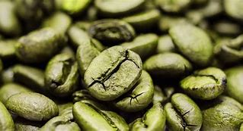

Research Hypothesis
What should I prefer – Green Tea or Green Coffee?

Slide 49
Phase 1
What happens to green coffee in the body?
Is Green Coffee tolerable?
How much coffee / day can be tolerated safe in healthy adults?

Slide 50
Phase 2
Does Green Coffee Work?
Define the parameter – Weight loss, Immunity, concentration
How much coffee / day is safe in healthy adults?

Slide 51
Phase 2A, 2B
Phase 2A: 1 cup/ per day (SD) to 4 cups/ day (Ascending dose)
Phase 2B:
1 cup – effect observable?
2 cups – Effects, Any Tolerability isses?
3 Cups – Effects, Tolerability issues?
4 Cups – Side effects e.g. sleep reduced? Max tolerated dose per day

Slide 52
Phase 3
Is green coffee better than green tea?
Randomized, controlled study, comparing 2 cups of green coffee versus green tea in reducing weight/ increasing immunity / improving concentration?
  Primary objective: Study for 1 month eg weight loss of 4 kg
  Secondary objective: long term efficacy, loss of therapeutic response

Slide 53
Phase 3
Phase 3A: Data submitted for 1 month for approval
Phase 3B:
  Subjects on green tea may cross over to green coffee, after they start gaining weight
  Data being collected to study extension of benefit eg 3 months, 6 months

Slide 54
Phase 4
Is long term consumption of green coffee safe?
Other conditions benefited by green coffee?
Is it safe when taken with regular coffee?
Can people with acidity have green coffee?

Slide 55
Short Summary

Slide 56
Phases of Pharmaceutical Investigation
0
      Animal Toxicology
      Toxicology
      In-vitro studies
Pre-clinical
INVESTIGATIONAL NEW DRUG APPLICATION
      Safety Evaluation in volunteers
      Dose ranging studies
      Human Pharmacokinetics
      First Clinical evaluation in target patient
      population
      Safety and efficacy studies of large
      number of patients
      Long term post-marketing surveillance
      and expanded clinical investigation
20-80 patients
I
II
100 patients
C L I N I C A L
III
100-1000 patients
NEW DRUG APPLICATION / MARKETING APPROVAL
IV
Variable no. of patients
Notes:
Initially, pre-clinical data about a drug are collected. Pre-clinical investigations are studies of drug effects in laboratory animals (in vivo), toxicologic studies, and studies of drugs in an artificial environment (in vitro) such as a test tube. Researchers conduct pre-clinical investigations to predict whether initial human studies will be acceptably safe and to predict, if possible, the drug’s likely therapeutic effect.
If therapeutic and safety profiles of a drug under pre-clinical investigation are reasonable, the drug undergoes a sequence of rigorous clinical tests. Phase I clinical research consists of studies designed to measure the pharmacologic action and safety of the agent in healthy volunteers, usually male adults. Dose-related side effects, therapeutic effects, pharmacokinetic characteristics, and metabolic data are recorded.
Phase II consists of the first controlled clinical trial of the drug in the target patient population. The purpose of Phase II is to assess the safety and efficacy of the drug in a small number of patients.
Phase III consists of extensive, expanded controlled clinical trials. Typically, Phase III studies are mulit-center tirals. The results of these studies should constitute enough evidence of the drug’s effectiveness and relative toxicity to permit adequate evaluation of its benefit-to-risk ratio.
Phase IV are done after the drug has been approved by the regulatory agency (BFAD). These studies may further assess drug effects on morbidity and mortality, or drug effects in a patient population not adequately studied during the pre-marketing phase. These include post-marketing surveillance studies.
(Reference: Med Text, Inc. Guide to Clinical Research Papers. 1985. 5-6.)

Slide 57


